Slide 1
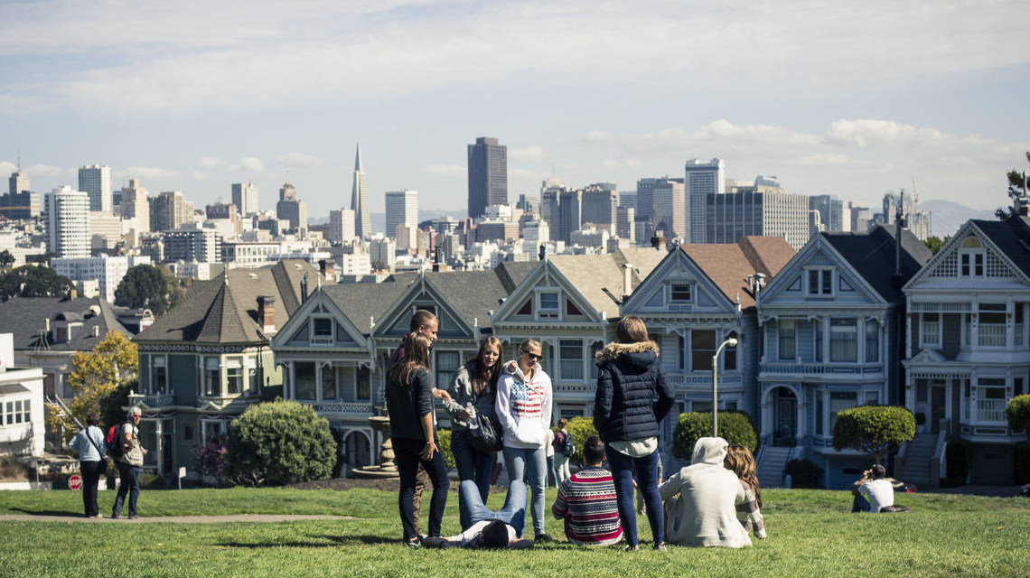
Localebnb
An Airbnb Contextual Recommender
G Scott Stukey
Notes:
Backgroun an image of my app.

Slide 2
Motivation
When booking a private residence,
how do you find the perfect neighborhood?

Slide 3
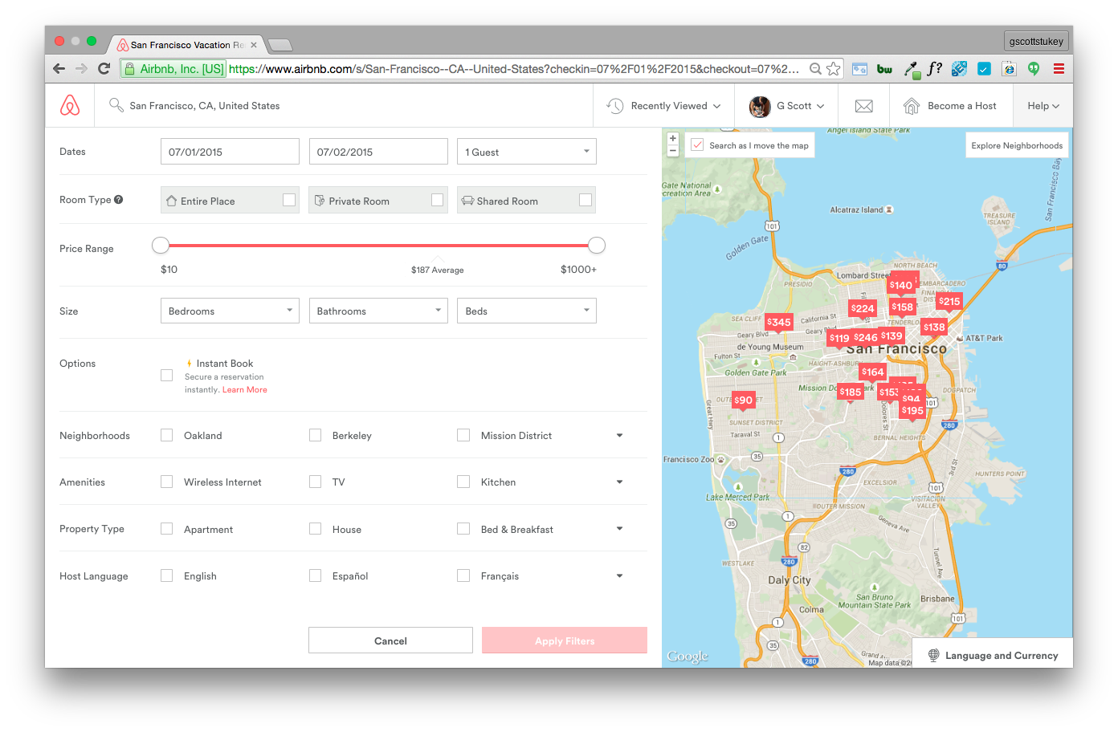
Problem
Airbnb search results
No ability to
search or filter
by trait!

Slide 4
Hypothesis
Use Airbnb listing descriptions to predict neighborhood traits
& customize search results to user's trait preferences
Rationale for Airbnb to implement:
Increase user satisfaction by increasing relevance
Increase booking rate by reducing bounces (click fatigue)

Slide 5
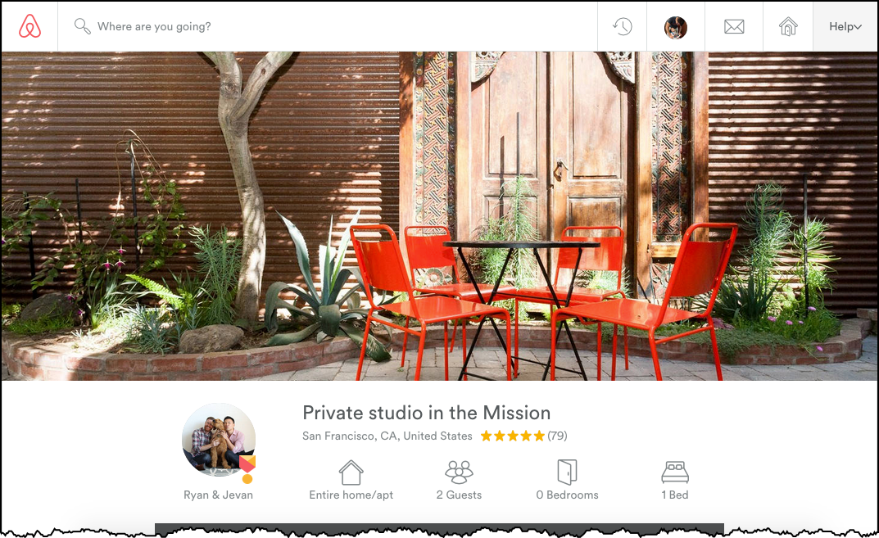
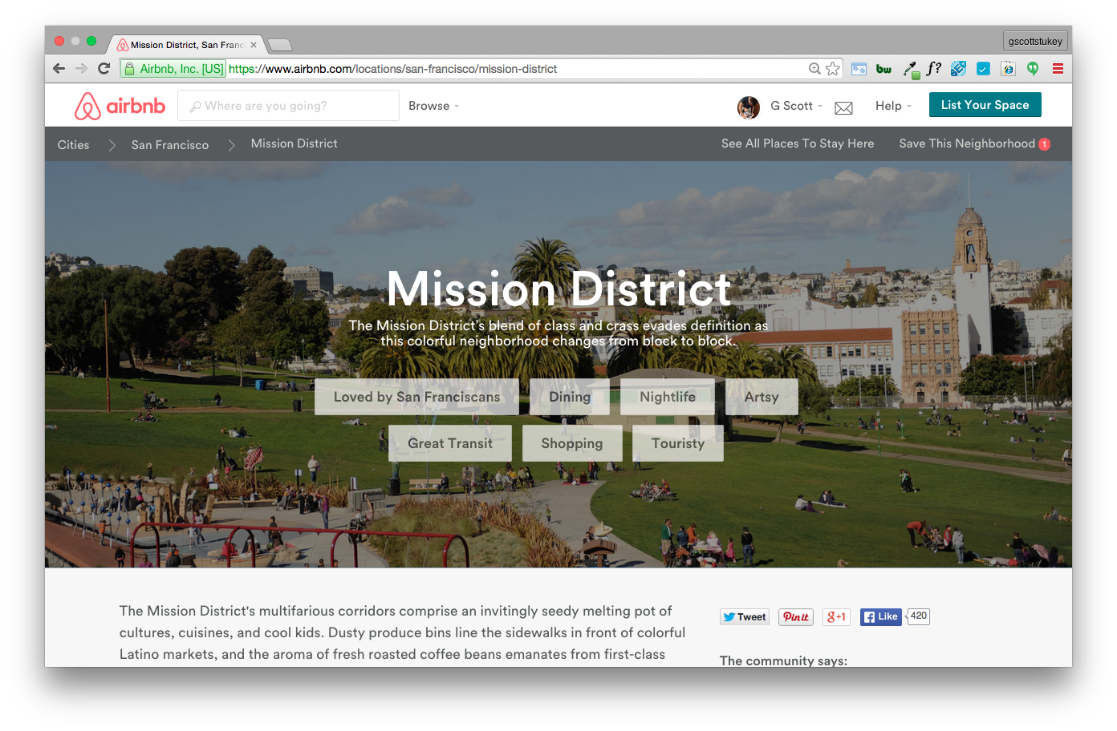
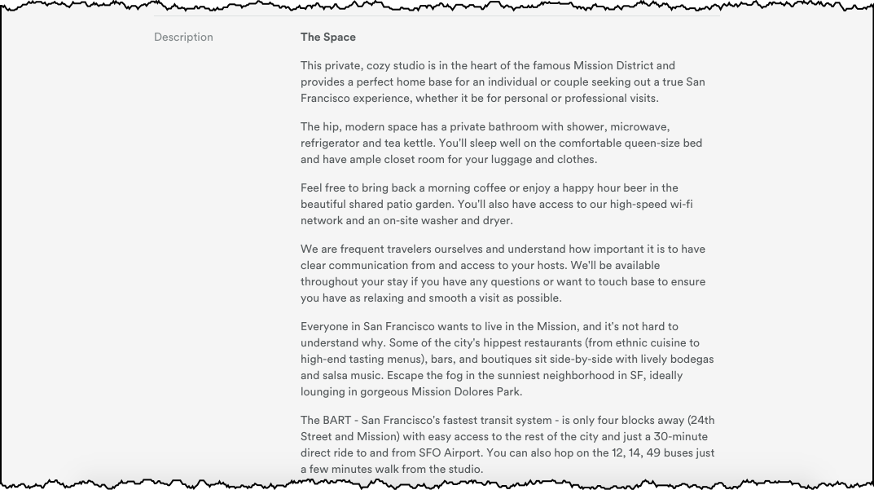
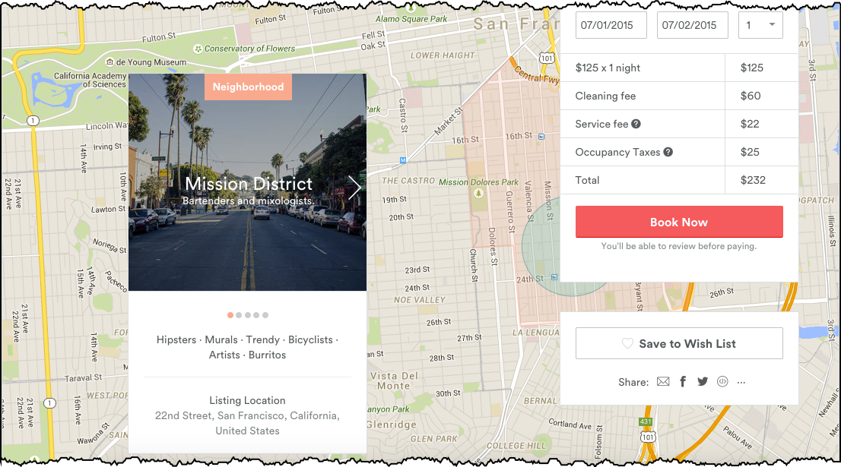
Solution
Listing Page
Neighborhood Guide
Features
Target

Slide 6
Methodology
Beautiful
Soup
+
ETL
Scraped Listings Descriptions
Scraped Neighborhood Traits
Prepping
Cleaned Documents (lemmatization, expand contractions, et al.)
NLTK
Modeling
Word2Vec / Doc2Vec
TF-IDF Vectorization
Naïve Bayes
SVM
Gradient Boosted Trees
Word2Vec
Rank/Sort
Implemented Custom Weighting & Scoring Function

Slide 7
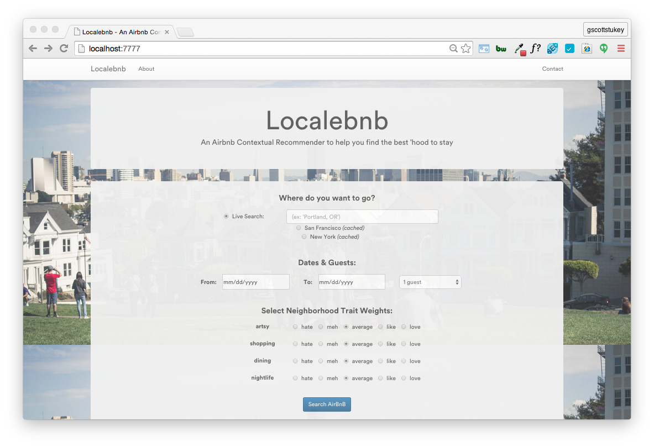
Localebnb

Slide 8
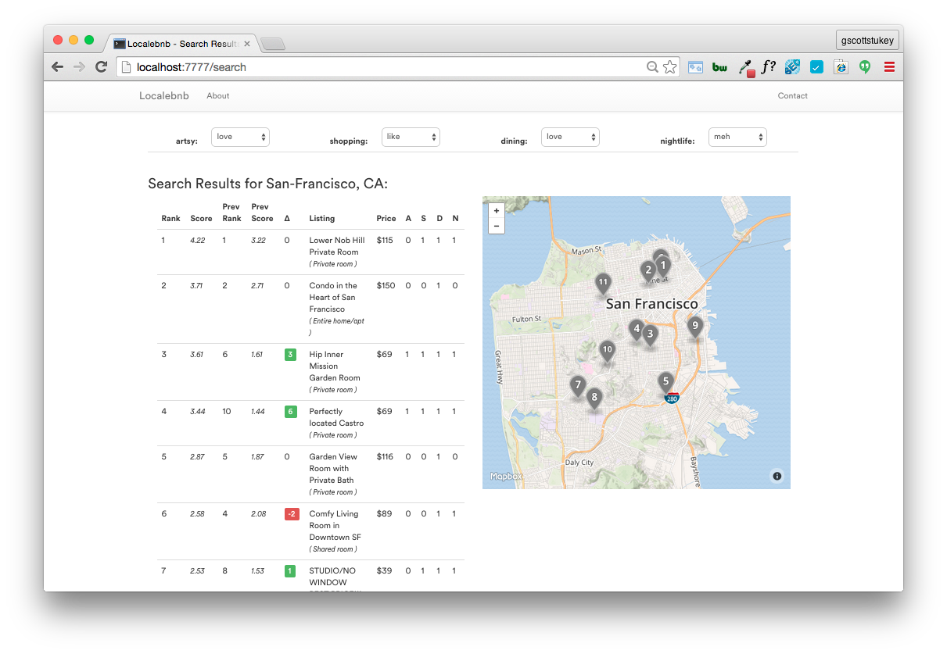
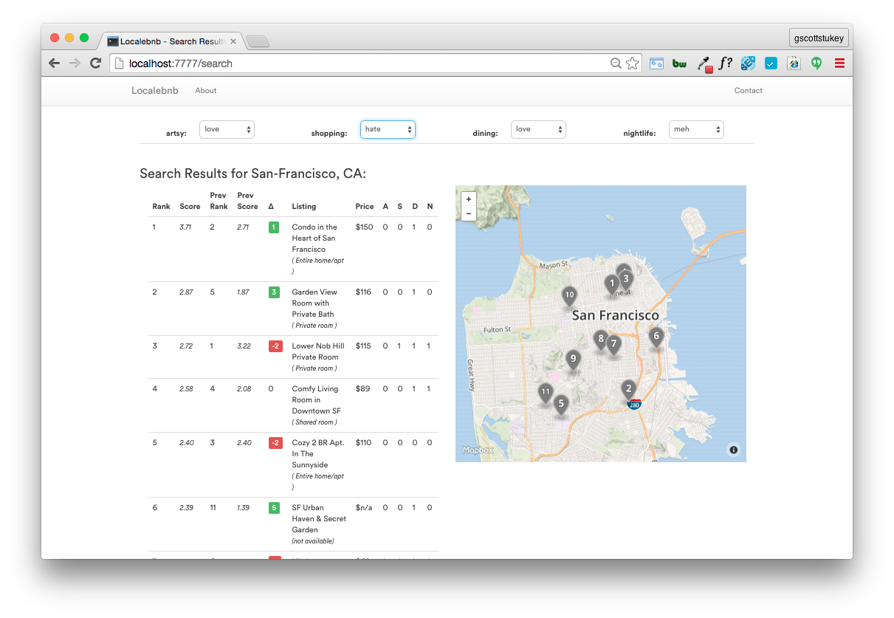
Localebnb > Search

Slide 9
Outcomes
78 - 82% accuracy with the SVM models for traits
Averaged 15 pt lift over ‘majority class’ benchmark model
Additional Applications:
Can aid content team’s neighborhood guides for new cities
Could share findings with hosts to help in writing descriptions

Slide 10
Thank You
G Scott Stukey
Notes:
Backgroun an image of my app.

Slide 11
Appendix
Notes:
Backgroun an image of my app.

Slide 12
Reference
Images
Source: https://www.airbnb.com/locations/san-francisco/mission-district
Source: https://www.airbnb.com/s/San-Francisco--CA--United-States?checkin=07%2F01%2F2015&checkout=07%2F02%2F2015
https://www.airbnb.com/rooms/3380099?checkin=07%2F01%2F2015&checkout=07%2F02%2F2015

Slide 13
Throwaway
Notes:
Backgroun an image of my app.

Slide 14
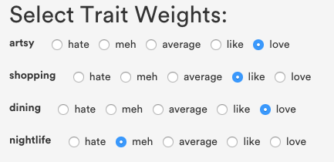
Example
AirBnB Listing Thumbnail A
AirBnB Listing Thumbnail C
Artsy | Shopping | Dining | Nightlife
👍 | 👍 | 🚫 | 👍
AirBnB Listing Thumbnail A
AirBnB Listing Thumbnail B
X
=
Artsy | Shopping | Dining | Nightlife
🚫 | 🚫 | 👍 | 🚫
AirBnB Listing Thumbnail C
AirBnB Listing Thumbnail B
Artsy | Shopping | Dining | Nightlife
👍 | 👍 | 👍 | 🚫
Notes:
(ALTERNATIVE VIDEO)

Slide 15
Solution
Map to Listing
Target Variables

